Slide 1
Organizing Human Resources and Contracting
Delegation:
What to delegate?
Authority Delegation
Mere assignment of any task is not delegation
Delegation occurs when authority is formally passed on to make commitments, use resources, issue instructions, demand adherence and take necessary actions for the performance of the tasks
Institutional delegation must be in writing and appear formal & should contain legal overtones

Slide 2
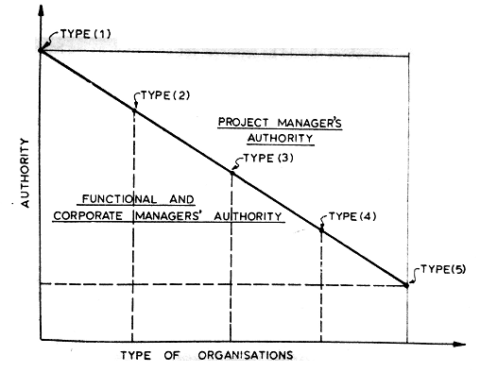
Project Manager’s Authority

Slide 3
Responsibility – Moral obligation to produce results
Responsibility is an attitude of mind which cannot be passed on in writing; and to that extent the delegator, whatever authority he may pass on, will still be responsible for the tasks
Hence, responsibility cannot be delegated
Accountability - Authority has to be used for a cause, it must be made accountable

Slide 4
When to Delegate?
Overburdened and cannot handle all the tasks in the required time though one has the know-how
Does not have the know-how and is not interested in building up the same as it may not be of any use in future
Job is so specialized that it is either not possible to build up the capability or build it by the time it is needed
Someone can do it better qualitatively, economically and on time

Slide 5
Work is not secret
The intention is to develop staff or growth of ancillary organizations
The work is routine and the delegator’s time can be more effectively utilized by diverting his attention from routine areas
How to Delegate?
The delegate must be given a complete picture of what he has to do, how to do it and how much authority he has to get it done
Delegatee must accept the responsibility

Slide 6
Delegation involves certain amount of bargaining
If delegation is not made properly it may boomerang on the delegator
Project Manager’s Authority
Project Scope
Project Goals
Project execution mode
Project organization
Project purchase
Contracts, contractors and consultants

Slide 7
Project technical performance
Project schedules and budgets
Fund and other resources
Project personnel
Public/Shareholders
Project environment
Management systems and procedure
Project performance review

Slide 8
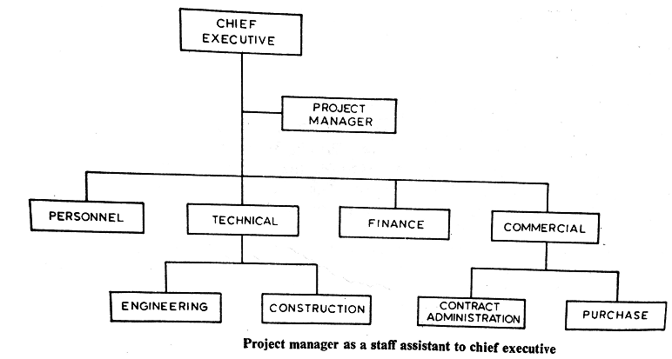
Project Organization

Slide 9
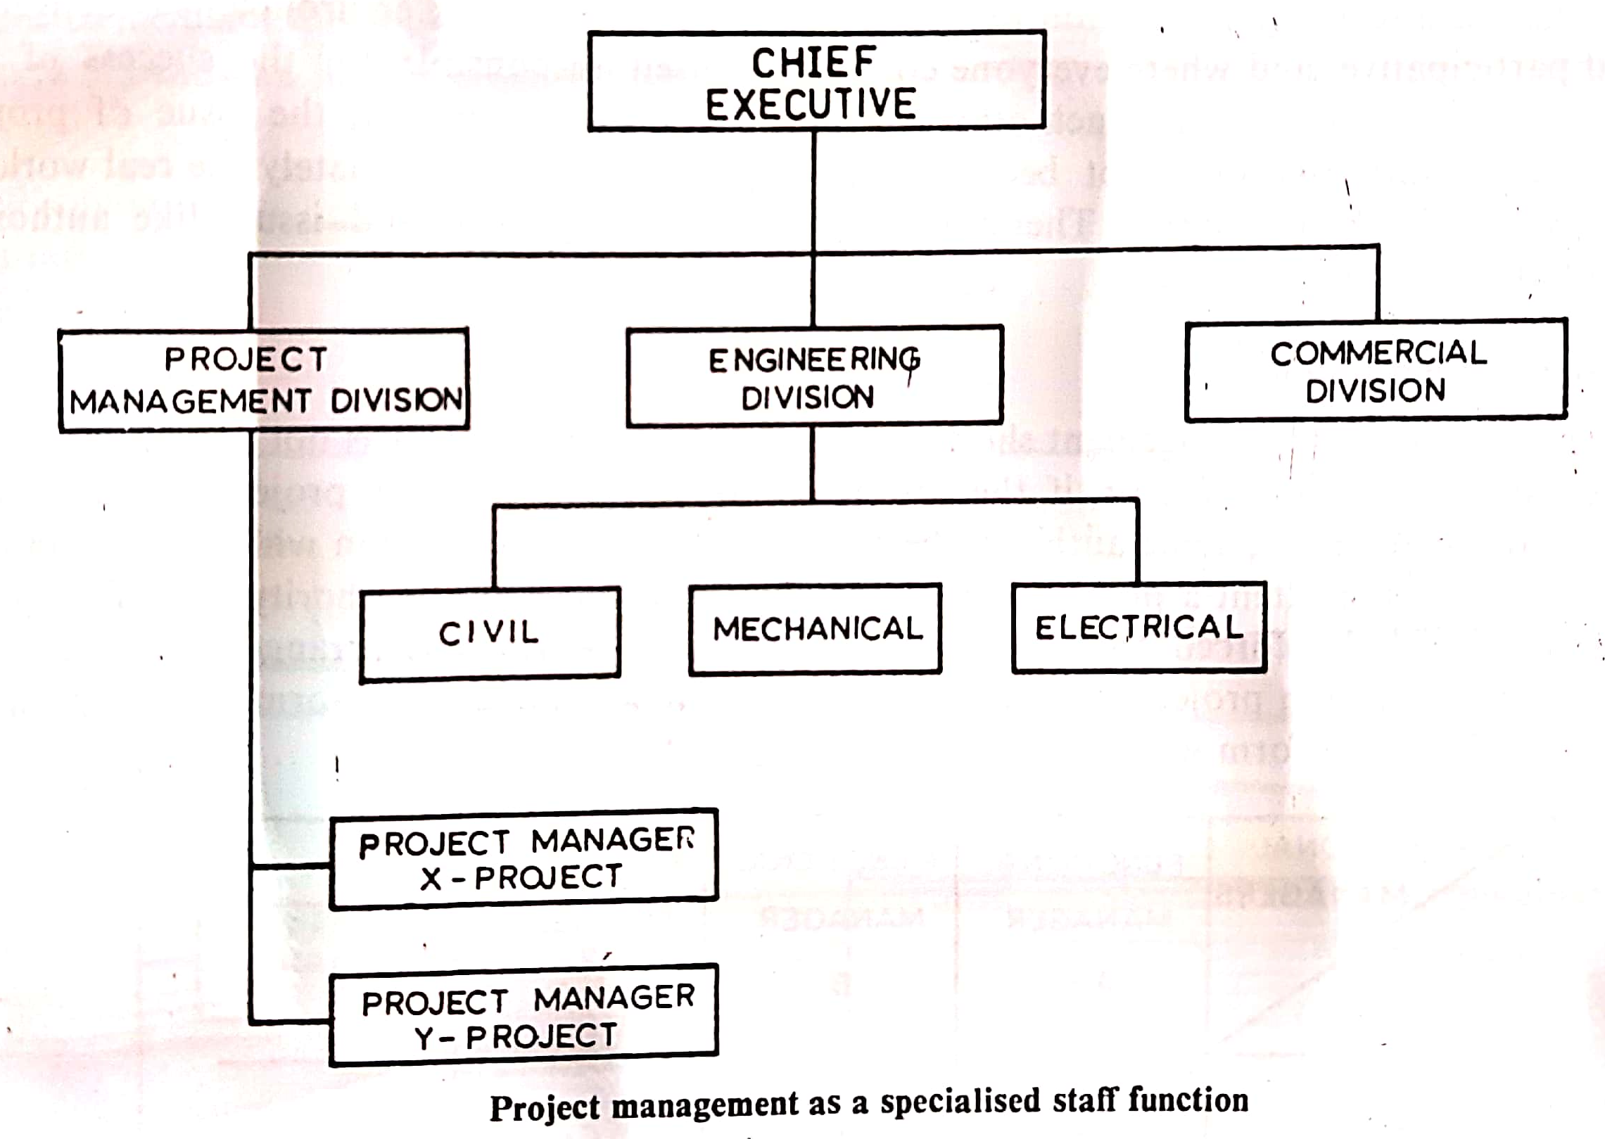

Slide 10
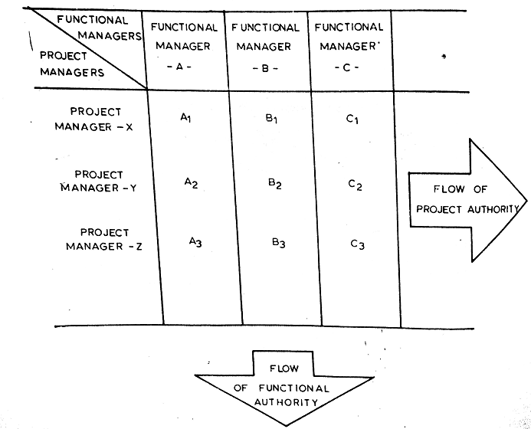
Matrix Organization

Slide 11
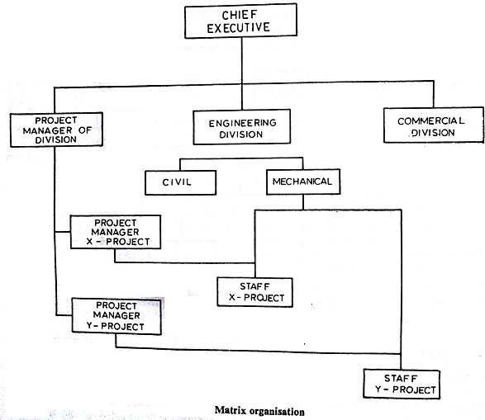

Slide 12
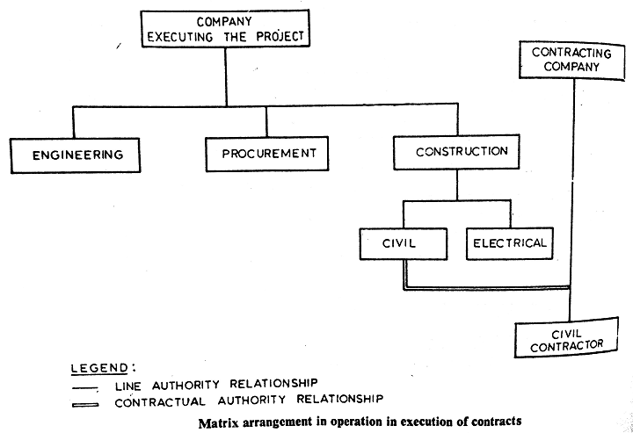

Slide 13
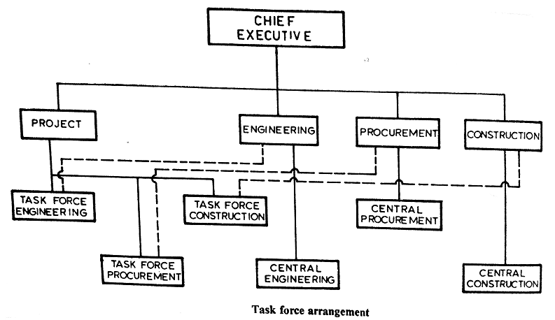

Slide 14
Task Force Organization:
Clearly accords authority to the project manager
Project manager is delegated full authority to make decisions for the project
He would be required to operate within the functional organization's policies & procedures
A task force is created by drawing personnel from various functional departments and putting them under the project manager

Slide 15
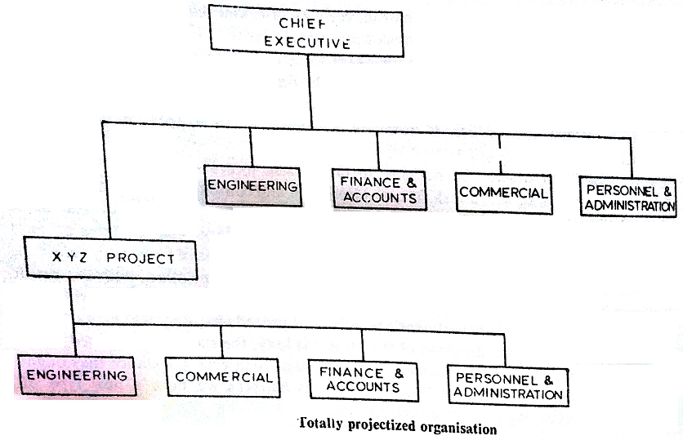

Slide 16
Authority – accountability with various organizations
Project Manager as a staff
Authority |  | Accountability
Project Manager | Functional Manager | Project Manager | Functional Manager
Does not make any decisions for the project, collates & communicates information | Decides what has to be done, how it has to be done, when and at what cost in their functional area | Cannot be held accountable for any performance parameter of the project. Accountable for timely reporting | Can be held accountable for individual functional performance. Cannot be held accountable for overall project time and cost

Slide 17
Authority – accountability with various organizations
Consultant as a project manager
Authority |  | Accountability
Project Manager | Functional Manager | Project Manager | Functional Manager
Does not make decisions , betters systems, procedures, and guidelines for project implementation. Trains staff , monitors implementation and makes recommendations | Decides what has to be done, how it has to be done, when and at what cost in their functional area | Cannot be held accountable for any performance parameter of the project. Accountable for timely reporting | Can be held accountable for individual functional performance. Cannot be held accountable for overall project time and cost

Slide 18
Business Contracts
A contract is an agreement between two or more parties in writing, to do or not to do certain things
Business contracts are those agreements which are enforceable at law
Legal consideration which is usually payment in the form of money

Slide 19
Necessity of business contracts
Sequence: Enquiry Offer Acceptance Agreement Contract
3 ‘R’s of Contracting
Responsibility
Reimbursement
Risk

Slide 20
Lump sum contracts
1.1 Lump sum – Fixed price arrived by way of competitive bidding
1.2 Negotiated lump sum: A fixed price is negotiated with the contractor selected on consideration other that price
2. Cost plus contracts
2.1 Cost plus percent fee:
a) For services:
Actual man hour x rate= say A + % of A for overhead=say B, + agreed %(A+B) as fees + out of pocket cost at actuals

Slide 21
b) For supply:
Equipment costs at actuals + agreed % fee for service
c) For turnkey project:
Installed plant cost at actuals + agreed % fee for services
2.2 Cost plus with fixed fee: Fee component is fixed and not linked with other cost which will be reimbursed at actuals

Slide 22
2.3 Cost plus with guaranteed maximum:
Reimbursement to the contactor is on the basis of cost plus and % fee or fixed fee such that the total price does not exceed a predetermined amount. If the contractor incurred more cost than this figure to complete the work, some part of the extra cost will be borne by him

Slide 23
2.4 Cost plus with guaranteed maximum and incentive ( Also known as target cost contracts):
Same as above except if the final cost is lower than the target, some part of the saving will be passed on the contractor. In both 2.3 & 2.4 escalation clause must be included to protect the contractor from developments beyond his control
2.5 Fixed rate contract: Contractor is reimbursed for his expenditures, measured in days or hours, at agreed rates per man hour or per man day without the total number of hours or days being fixed.

Slide 24
3. Item rate Contracts:
A detailed schedule of items giving brief description of the work or supplies with approximate quantity is introduced in the contract, and the contractor offers a unit rate against each item. Rates may also be obtained against items not quantified. Payment is made against the aggregate of various quantities actually executed at rates quoted by the contractors. Beyond a certain % variation in the quantity specified in the schedule or total values of the contract, rates may require to be renegotiated.

Slide 25
4. Convertible contracts: Works on cost-plus basis till scope of work can be defined and later converted to lumpsum
5. Hybrid contracts:
5.1 Lump sum + item rate: The contract in such cases may be divided into two parts. The parts where design parameter and/or quantities are frozen are put on lump sum. For the balance parts where quantities may change during detailed design, item rates are invited from the contractor against schedule of item with no or very rough quantities

Slide 26
5.2 Lump sum + cost plus: Same as above except that where the details of the second part cannot be even roughly estimated the same can be put on cost-plus.
5.3 The lump sum portion may refer to supplies, design or for such scope of work which can be fully defined. For services like commissioning or construction supervision or escalated period reimbursement may be made at an agreed fixed rate.

Slide 27
Tender: An offer to carry out certain work or supply certain material or services in accordance with clearly detailed descriptions & conditions
Tendering procedure involves:
Prequalification of contractors
Preparation of tender documents
Mode of floatation of enquiry
Receipt of tender
Guidelines for evaluation of tenders
Selection of contractor

Slide 28
Risk Factor
Risk and uncertainty
Identification of risks
General conditions of contract (GCC)

Slide 29
Tendering & Selection of Contractor
GCC lists provisions to protect against uncertainties arising in the normal course of work, presuming that the parties entering into a contract are competent technically, financially and managerially
A well laid out procedure for prequalification of contractors and tendering can resolve this uncertainty. Such a procedure is known as tendering procedure

Slide 30
References
Project Management: Choudhry S., Tata McGraw-Hill, 2010
Projects: Planning, Analysis, Financing, Implementation, and Review - Prasanna Chandra, 5th edition, Tata McGraw-Hill publishing company limited, 2005
Project management a system approach to planning scheduling and controlling- Harold Kerzner, CBS Publisher and distributors, 2002.
A management guide to PERT and CPM- WEIST and Levy Eastern Economy of PH 2002.
T R Banga, N K Agarwal and S C Sharma -Industrial engineering and Management Sciences, -Khanna Publishers

